Slide 1
Eye Controlled Wheelchair
Workflow
Literature
Introduction
Timeline
Objective
Title 8
Results
Tools & software

Slide 2
Introduction
The wheelchair is multi-functional. The chair can be used as panic alarm. If the person needs instant help, he/she can seek some help by moving to the place so that someone can help him/her immediately.
Timeline
Workflow
Literature
Introduction
Outcomes
Results
Tools & software
Objective

Slide 3
Objective
The Objective is to create an Eye Monitored System which allows movement of the patient’s wheelchair depending on the eye movements.
Problem Statement:
To design a vision-based wheelchair system. Using the camera/webcam to acquire user images and analyzing user intent using eye gestures.
Workflow
Literature
Introduction
Results
Objective
Timeline
Outcomes
Tools & software

Slide 4
Literature Review
1.Eye-Controlled Wheelchair using Infrared Detection
Faculty College of Engineering, National University,
Manila, Philippines.
2.Eyeball Motion and Joystick Controlled Wheelchair
with Obstacle Detection
E&TC, Sandip institute of engineering and management,
Nashik, India
3.Voice And Vision Controlled Wheelchair For Disabled
G Uday Kiran (A), N Nithesh Chakravarthi (B), K R Radhakrishnan © PSG College of Technology, Coimbatore.
4.Electric Wheelchair Control Mechanism Using Eye-mark Key Point Detection
Gusti Pangestu1* Fitri Utaminingrum
Literature Review
Workflow
Introduction
Timeline
Objective
Outcomes
Results
Tools & software

Slide 5
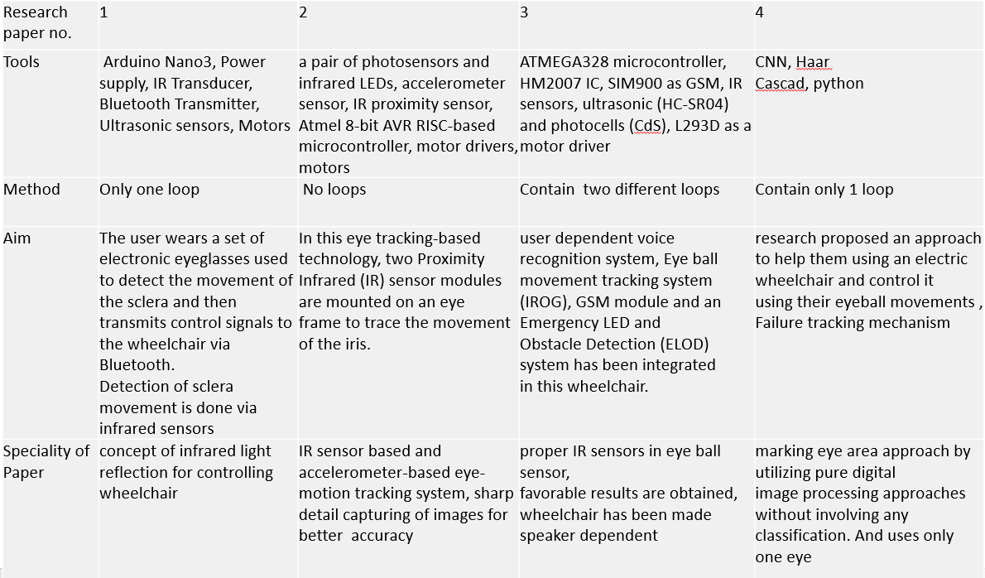
Literature Review
Literature Review
Workflow
Introduction
Results
Objective
Timeline

Slide 6
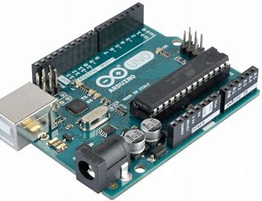
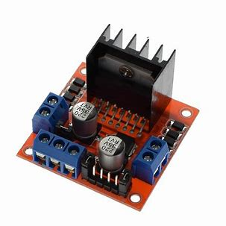
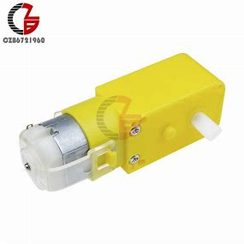
Tools and Software
Tools/Software:
Matlab
Arduino IDE
Hardware:
Arduino Uno R3
DC Motor
H-bridge Motor Driver
9V Battery
Workflow
Tools & software
Introduction
Literature
Results
Objective
Timeline
Outcomes

Slide 7
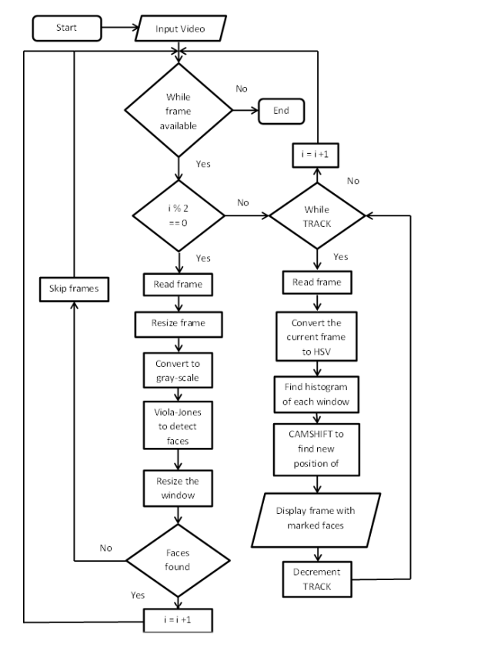
Workflow
Literature
Introduction
Results
Objective
Timeline
Outcomes
Tools & software

Slide 8
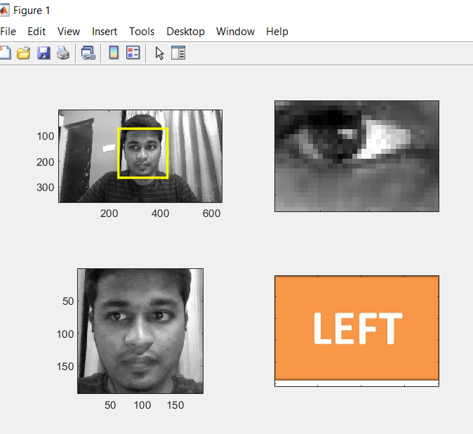
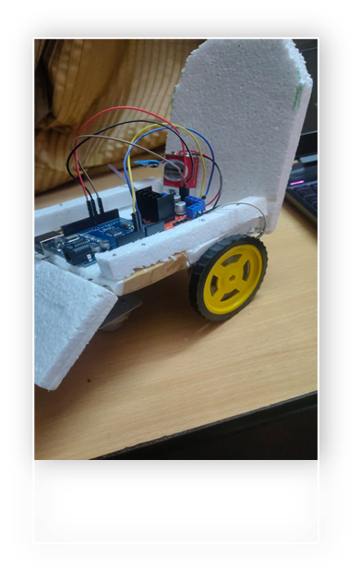
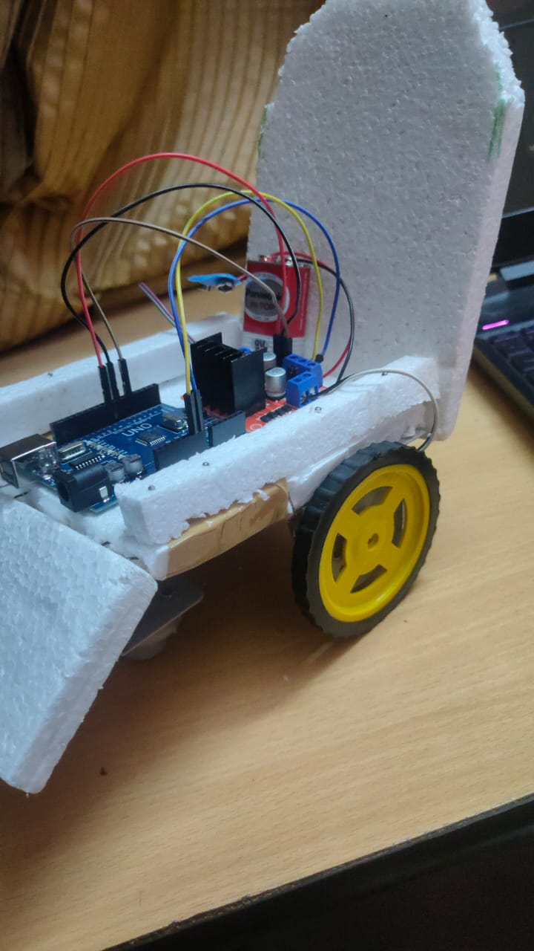
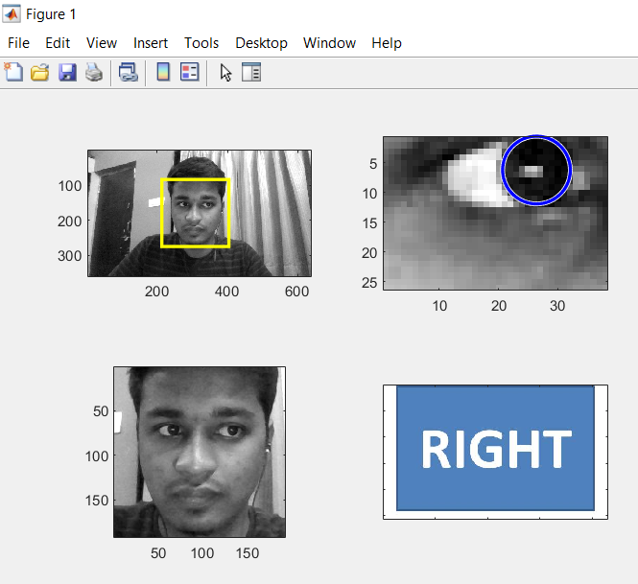
Timeline
Workflow
Literature
Introduction
Title 9
Results
Objective
Outcomes
Tools & software

Slide 9
Goal to be achieved | Time
Make a list of topics | Sept 21
Finalize the Problem Statement | Sept 27
Understand and practice the tools | Oct 15
Learn the technology & Design the System | Nov 21
Validation and Testing | Dec 21
Final Prototype / Product | Jan 23
Outcomes
Timeline
Workflow
Literature
Introduction
Future Scopes
Results
Tools & software
Objective

Slide 10
Outcomes
1. The wheelchair should be able to perform tasks on the person’s eye motion.
2. The project should perform satisfactory with performance accuracy of around 70-90%.
3.An Intelligent and Low-Cost wheelchair System
Timeline
Workflow
Literature
Introduction
Title 10
Outcomes
Results
Objective
Future Scopes
Tools & software

Slide 11
Future Scopes
A panic alarm can be added.
Reliability can be increased.
Face Recognition module can be included.
Timeline
Workflow
Literature
Introduction
Outcomes
Results
Objective
Future Scopes
Tools & software

Slide 12
THANK YOU!
Timeline
Workflow
Literature
Outcomes
Results
Objective
Future Scopes
Tools & software

